Slide 1
The Bells are Ringing
Uva 12119, LA4060
Time: 9 seconds

Slide 2
Problem Descriptions (1)
Perhaps you all have heard the mythical story about Tower of Hanoi (The details of this story is not required to solve this problem): ‘There is a tower of Hanoi with 64 disks and three pegs and the preists make one move everyday and the earth will be destroyed when all the pegs have been moved from one peg to the other following the rules of Tower of Hanoi.’ In this problem we deal with a similar story.

Slide 3
Problem Descriptions (2)
The story of an ancient temple. The ancient temple has three incredibly large bells.
At the beginning of time the three bells rang together.
Then the three bells never rang together and when they will ring together again the earth will be destroyed. The three bells have cycle length of t1, t2 and t3 (Here t1 < t2 < t3 and all are expressed in miliseconds).

Slide 4
Problem Descriptions (3)
By this I mean that the first bell rings at every t1 seconds from the beginning, the second bell rings at every t2 second from the beginning and the third bell rings at every t3 second from the beginning.
Also note that the difference of the values of t1, t2 and t3 is not that much different so that ordinary people think many time that they are ringing together.

Slide 5
Problem Descriptions (4)
Given the time difference between destruction of earth and beginning of time you will have to find the values of t1, t2 and t3.

Slide 6
Input
The input file contains at most 600 lines of inputs.
Each line contains an integer which denotes (in millisecond) the time difference between the beginning of time and the time of the bells ringing together.
Input is terminated by a line containing a single zero. All the input numbers will fit in a 64 bit signed integer.

Slide 7
Output (1)
For each line of input produce two lines or more of output.
The first line contains the serial of output.
Each of the next lines contains three integers which denote the values of t1, t2 and t3 respectively.
The value of t1, t2 and t3 is such that t1 < t2 < t3 and 0 < t1, t2, t3 ≤ 1000,000 and |t1 − t3| ≤ 25.

Slide 8
Output (2)
If you cannot find values of t1, t2, t3 with such constraints then print the line “Such bells don’t exist” instead.
In case there is more than one solution sort the output in ascending order of the value of t1, then (in case of a tie) in the ascending order of the value of t2 and then (still a tie) in ascending order of the value t3.
Print a blank line after the output for each test case. Look at the output for sample input for details.

Slide 9
Sample Input/Output
10
103
0
Scenario 1:
1 2 5
1 2 10
1 5 10
2 5 10
Scenario 2:
Such bells don't exist

Slide 10
|5-1|<25
Scenario 1:
1 2 5
1 2 10
1 5 10
2 5 10
Scenario 2:
Such bells don't exist
1 | 2 | 3 | 4 | 5 | 6 | 7 | 8 | 9 | 10
1
2
5
|10-1|<25
1 | 2 | 3 | 4 | 5 | 6 | 7 | 8 | 9 | 10
1
2
10
|10-1|<25
1 | 2 | 3 | 4 | 5 | 6 | 7 | 8 | 9 | 10
1
5
10
|10-2|<25
1 | 2 | 3 | 4 | 5 | 6 | 7 | 8 | 9 | 10
2
5
10

Slide 11
Solution
factor
0 | 1
2 | 5
f_cnt==2
cnt
0 | 1
1 | 1
num
0 | 1 | 2 | 3
1 | 2 | 5 | 10
total==4

Slide 12
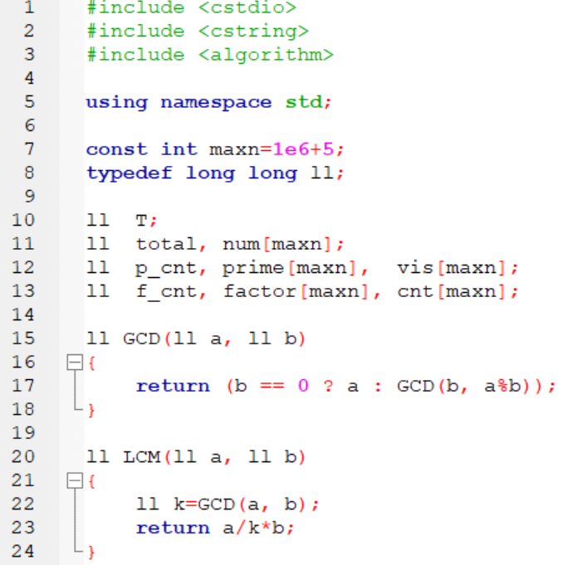

Slide 13
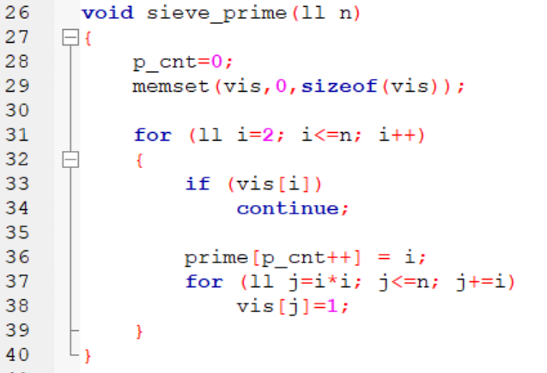

Slide 14
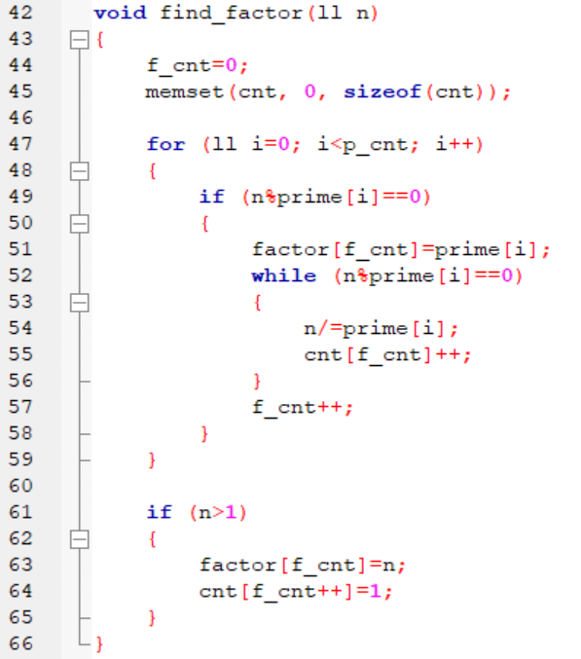

Slide 15
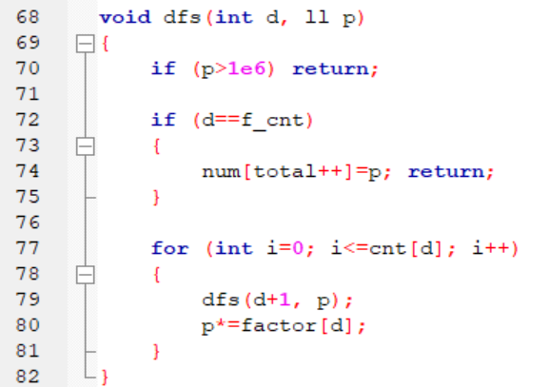

Slide 16
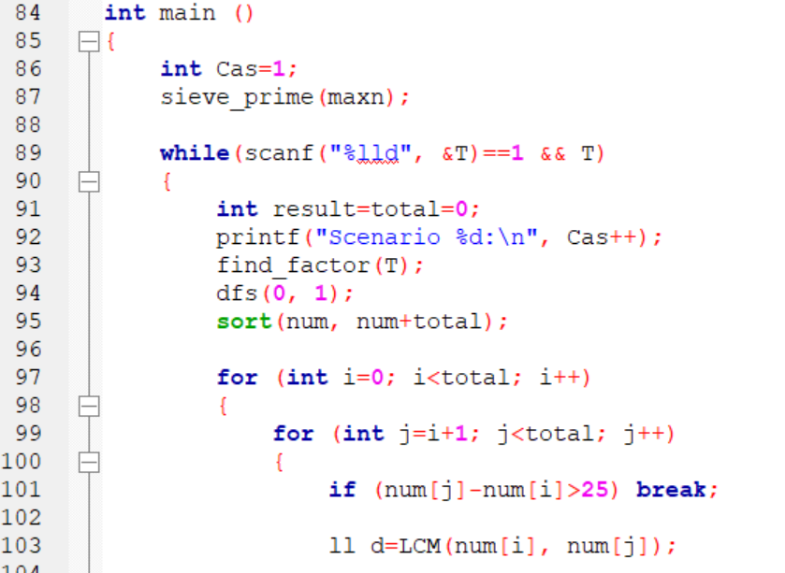

Slide 17
